Slide 1
Solution Pluralism
(And its relevance to KAPSARC)
Steven O. Kimbrough
22 May 2014 File: KAPSARCTalk20140522.pptx

Slide 2
Outline
Motivations and basic concepts.
  What’s this about and why?
Example 1: GAP, etc.
  Show you once.
Example 2: Redistricting.
  Show you again.
Looking forward.
  Great opportunities ahead and in view.

Slide 3
Three Verities
Goal of optimization
  Given an optimization model, the primary problem posed is to find an optimal solution to the model.
  Note: optimization as the seeking of a setting of the decision variables (“a solution”) for the problem, for which there is no superior setting (no better solution).
Justification of heuristics
  Exactly optimal solutions (to optimization problems) are always preferred, but heuristically optimal solutions are acceptable if exactly optimal solutions are not available. (The great NP-hard divide. Drawing a map, leaving out details.)
  This is why meta-heuristics (GAs, evolutionary computation, simulated annealing, etc.) may (sometimes) be justified.
Stylized models for insights
  In practice our models, such as knapsack, GAP, etc., are admittedly stylized and simplified from actual problems, but they have important value for the insights they give us into decision making, and this is the primary value, which is often supplied by exact methods.

Slide 4
What’s Not to Like?
Claim, these verities may be true, but they aren’t true enough.
In a nutshell:
Goal of optimization
  An optimal solution? No: we would like all of the optimal solutions.
Justification of heuristics
  Second fiddle to exact solutions? Not if exact solvers cannot provide us with a plurality of solutions of interest. (Because we want these, too.)
  Solutions of interest (SoIs)? More on this later. For now: near-optimal solutions.
Stylized models for insights
  Isn’t an exact solution for an approximate model better than an inexact one?
  Why just one? Why not a plurality of solutions? And
  Why not have a more realistic model (accepting heuristic solutions to it)?

Slide 5
Framework (To Be Illustrated with Examples)
Given an optimization (or even satisfaction) problem:
  Identify, characterize the solutions of interest (SoIs)
Example (for a COP): Feasible solutions of interest (FoIs): feasible solutions with high-quality objective values and improved on slack resources over the best known feasible solution.
    Why?
Example: Infeasible solutions of interest (IoIs): infeasible solutions, with superior objective values, that are not far from feasibility.
  Why?

Slide 6
Solution Pluralism?
Basic decision making schema
  Identify problem
  Build model
  Solve the model, obtain a solution
  Deliberate & decide
Basic decision making schema with solution pluralism
  Identify problem
  Build model
  Identify SoIs
  Find SoIs
  Deliberate & decide
In essence: characterize a set of (many) solutions and obtain (a good sample of the) members of that set; then use the sample for deliberation.
Comment: Typically, the sampling is best done with meta-heuristics, such as evolutionary computation (“GA”s, genetic algorithms)

Slide 7
Example 1: GAP
Generalized assignment problem
  Assign jobs to capacity-constrained servers.
  NP-hard, challenging in practice
Solution method: FI-2Pop GA [SOKetal. 2008]
  Simultaneously evolve two populations of solutions to the problem.
    Feasible solutions.
    Infeasible solutions.
SoI finding method
  M (say 2000) best feasible solutions encountered as measured by objective value.
  N (say 2000) best infeasible solutions encountered as measured by distance to feasibility.
  (Am simplifying. Other criteria of course; a topic for another day.)
Examined every member of a standard library of test problems (Beasley’s OR Library; [Kuo2014] etc.).

Slide 8
Representative Results
Can we find an optimal solution? Yes, two! (c530-2. 30 jobs, 5 agents)

Slide 9
Compare Them on Slacks
Decision makers may well prefer A over B or vice versa.
Of course, we could have encoded additional preferences or requirements into the original problem formulation. But:
That would make a hard problem harder.
The encoding is a lot work. Just eliciting all relevant preferences is a lot of work.

Slide 10
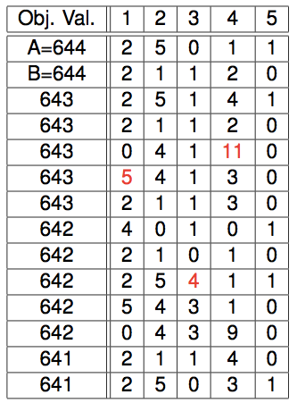
Shadow Price-Like Questions (FoIs)
With FoIs: Where might we be able to redeploy resources?
In both of my optimal solutions, constraint 1 has a slack of 2. Are there any good solutions available with a slack of at least 10?
Yes. #23 has a slack on constraint 1 of 10 and an objective value of 640; #53, 11, 638; #97, 13, 636.
And so on.

Slide 11
Shadow Price-Like Questions (IoIs)
Is there opportunity to acquire more resources?
To trade in slacks and surpluses?
We’re at 644, but we need to get to 651. Show me what I need to do.
In the top 1000 IoIs there are 75 discovered solutions with objective values at or above 651.

Slide 12
Shadow Price-Like Questions. >651? (IoIs)
Is there opportunity to acquire more resources?
To trade in slacks and surpluses?

Slide 13
Reduced Cost-Like Questions (with FOIs)
Job 25 is assigned to machine 2 in solution A and machine 3 in solution B. What’s the best solution if we assign job 25 to machine 1?
Answer: It has an objective value of 643. The solution is

Slide 14
Example 1: GAP, Concluding
We could go on.
Example illustrates essential principles.
  Identify SoIs.
    Here: high-quality feasible solutions and objective-superior infeasible solutions.
  Collect the SoIs.
    Here: as a by-product of the FI-2Pop GA solver for the problem.
  Deliberate with the SoIs.
    Illustrated above.
Generalizes to other problems
  GQAP [Kuo2014]
  Cross dock scheduling problem
  Two-sided matching [Kuo2014]
  Etc.

Slide 15
Example 2: Redistricting and Zone Design
Example of serious gerrymandering.
How to design better districting plans?
Required: contiguity and population balance (10%, 5%).
Desired: compactness and ?? (neighborhood integrity, …). [No generally agreed measure of compactness.]
Problem: Foxes guard the chicken coop. (Politicians choose voters.)
Widespread problem in American politics.
Example of larger class: zone design.

Slide 16
Example 2: Redistricting and Zone Design: Team Fred
Fred Murphy assembled a team to compete in a contest.
  Fred, Ram Gopalan, Nick Quintus, and Steve Kimbrough
Competed in two categories:
  Most compact district (by the Schwartzberg measure).
  Best plan that keeps the wards intact.
Wards?
  Philadelphia has 66 wards; political units defined by the City.
  Last set in about 1996; still perhaps the best available demarcation of neighborhoods. (Wards generally do not split neighborhoods, unless they won’t fit.)
Optimization problem: Bin the 66 wards into 10 districts, minimizing compactness, subject to maintaining contiguity and population balance.
The optimization is difficult. Stirling number of the second kind: 66, 10 ≈ 10^51. GA, don’t even think of IP. Contiguity?
  GA innovations; a separate topic.

Slide 17
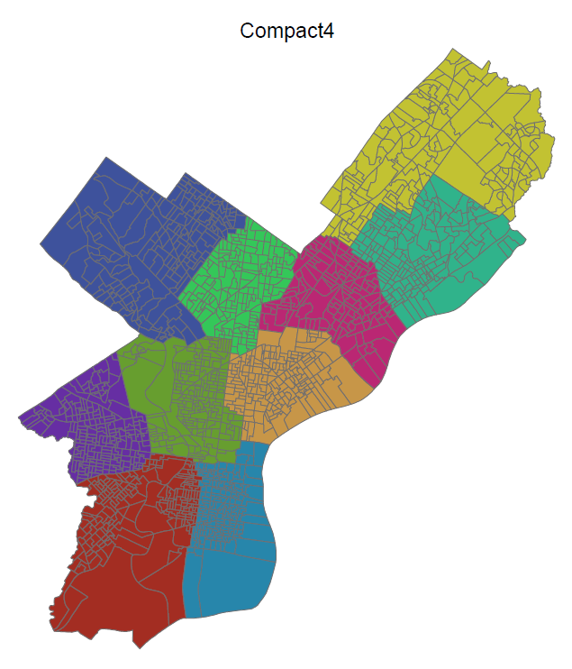
Upshot of the Contest
Our winning compactness entry (found by Fred; OR + trial and error).
On the optimization side, took a solution pluralism perspective and found 116 legally valid, mostly high quality districting plans that do not violate ward boundaries.
  Not submitted because of a change in contest rules.

Slide 18
Upshot of the Contest
Testimony
Two (Steve, then Fred). See: http://opim.wharton.upenn.edu/~sok/phillydistricts/
First: Do NOT implement the compactness plan, because it violates neighborhood integrity.
Second: DO ask us to find more plans. We’ll do it for free.
  They didn’t.
Latino community member:
  Q. “What do I do with all these 116 plans?”
  A. “Go to the Web. Look at the plans. Pick one you like and bargain from it.”

Slide 19
Further Upshot of the Contest
Since we couldn’t submit the 116 plans and the solution pluralism work to the contest, we submitted the work to the INFORMS 2012 Wagner Prize contest for innovations in OR.
  We didn’t win, but we were finalists and got a great response.
  See a video of our presentation and get our slides at https://live.blueskybroadcast.com/bsb/client/CL_DEFAULT.asp?Client=569807&PCAT=5277&CAT=5278
  Resulting paper in Interfaces http://dx.doi.org/10.1287/inte.2013.0697.

Slide 20
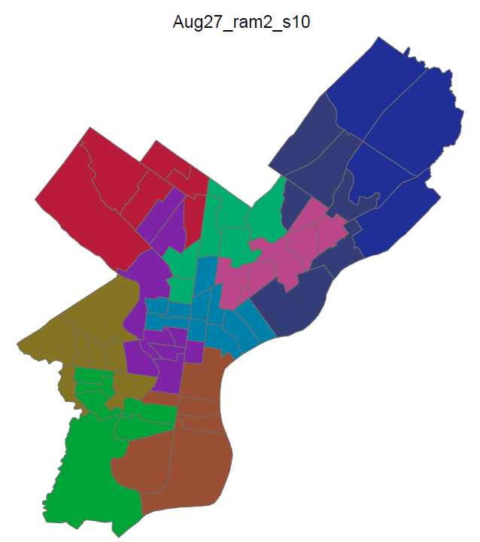
Example Plans Found by the GA
All found by the evolutionary algorithm (GA).
Our best plan on population balance.
Scored very high against the contest submissions in this category.
  But the winner had exactly equal populations in the districts!

Slide 21
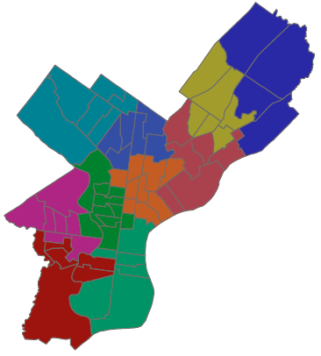
Example Plans Found by the GA
Our preferred solution.
Chosen subjectively by a team member to honor Philadelphia’s neighborhoods.

Slide 22
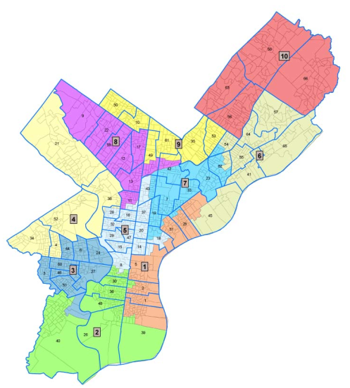
Comparison with What City Council Did

Slide 23
What We Learned
Solution pluralism can help when models are known to be inaccurate.
The presence of multiple good solutions to the model can afford reasoned deliberation with information not available to the model.
Solution pluralism is especially important when the objective function is a proxy for larger and less-well-defined objectives (or different legitimate objectives of different people).

Slide 24
What We Learned (con’t.)
In the face of model inaccuracies we have basically three choices, each of which may be appropriate depending upon circumstances:
  Do the best we can in building the model, obtain an optimal solution for it, act on an optimal solution, and hope for the best.
  Insist on an accurate model, then wait to decide until one is available and has a solution.
  Use the admittedly flawed model to support discussion and deliberation, implementing a modification of an optimal solution to the model in response to considerations not fully represented in the model.
See [Chou et al., 2013].
What is an accurate model in this context when the objective is ill-formed?

Slide 25
Further Lessons Learned
Districting (and zone design) is inherently strategic. Many stakeholders and many interests.
Solution pluralism, combined with optimization, can be used to set the rules of the game, to design the institution, so as to keep play within socially desirable bounds.
Our proposal for doing districting ≈ define the SoIs ex ante, then let parties compete to find them and advocate particular ones. “Pick one you like and bargain from it.”
  Ex ante characterization of SoIs, one hopes, will constrain the consideration set to reasonable solutions, yet leave room for bargaining and incorporation of new information.

Slide 26
Going Forward
Discover new uses of solution pluralism.
  Such as: robustness under risk (started [Kuo2014, etc.])
  (“Robust optimization” is under uncertainty.)
Find new and useful ways to define SoIs.
  Such as nearly-stable matches in preference matching problems.
Investigate computational effectiveness in finding SoIs.
  Such as, do different heuristics tend to find different solutions in the SoIs?
Investigate and innovate in using the SoIs to support deliberation.
  As a starting point for further search.
  Dealing with problems of scale.
  DEA for efficiency?
  Etc.
Applications
  Try more (beyond GQAP, two-sided matching, etc.),
  General tools.
  In support of specific applications/tools, such as KTAB.

Slide 27
References
[SOKetal. 2008] “On a Feasible—Infeasible Two—Population (FI-2Pop) genetic algorithm for constrained optimization: Distance tracing and no free lunch” (Steven Orla Kimbrough, Gary J. Koehler, Ming Lu, and David Harlan Wood), European Journal of Operational Research, 2008.
[Kuo2014] “UNVEILING HIDDEN VALUES OF OPTIMIZATION MODELS WITH METAHEURISTIC APPROACH” (Ann Kuo), Ph.D. thesis, University of Pennsylvania, 2014.
[Chou et al., 2013] “On empirical validation of compactness measures for electoral redistricting and its significance for application of models in the social sciences.” (Chou, C., Kimbrough, S. O., Murphy, F. H., Sullivan-Fedock, J., and Woodard, C. J.), Social Science Computer Review, 2013.http://ssc.sagepub.com/content/early/2013/04/09/0894439313484262
[Gopalan et al., 2013] “The Philadelphia Districting Contest: Designing Territories for City Council Based Upon the 2010 Census” (Ram Gopalan, Steven O. Kimbrough, Frederic H. Murphy, and Nicholas Quintus), Interfaces, 2013, http://pubsonline.informs.org/doi/abs/10.1287/inte.2013.0697

Slide 28
Backup Slides

